Slide 1
Untitled Team: Sprint 2
Scrum Master: Myles Wright
GUI/Front-End: Parker Winters
Full-Stack: Matthew O’Hern
Back-End: Nick Stitely

Slide 2
Project Information:
IT Help Desk Ticket Management System

Slide 3
Sprint 2 Goals:
Make wireframes for each user ticket page
Make database table for Tickets
Make database table for Notes
Create GUI for all user types
Create ticket form
Create User class
Create all children classes of User (Admin, IT Support Member, Project Member, Report Manager)
Create Ticket class and FAP Ticket class
Make snacks for Sprint 2 Presentation

Slide 4
IT Help Desk Project:
Live Demo!

Slide 5
Wireframe Design
Login form
Ticket list view for all users
Hamburger menu
Admin single ticket view

Slide 6
Front End: GUI
Revamping the GUI Design
Why go with custom buttons?
Color scheme

Slide 7
Connecting the forms to the database
Keep number of calls to the database to a minimum
Better performance

Slide 8
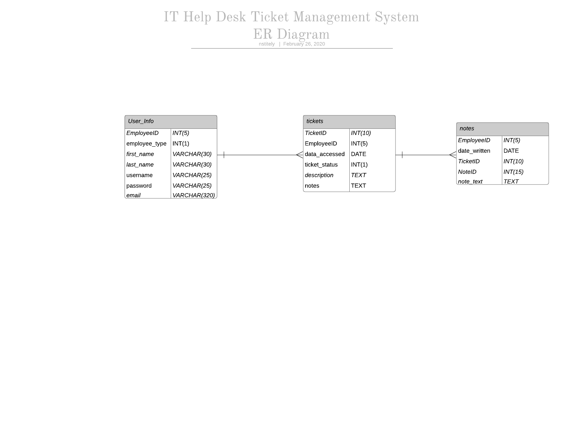
Back end: Database

Slide 9
Questions?

